Slide 1
midas_to_phiat Documentation
Sam Porter (wporter@triumf.ca)
University of British Columbia TRIUMF, on behalf of the TITAN Collaboration

Slide 2
Overview
Language: Python 3
midas_to_phiat.py converts MIDAS files output by the MPET DAQ to readable .csv files for input into PhIAT.m
Input: A directory address (i.e. address to a folder) of MIDAS Files (ex: /Users/wsporter/Documents/Physics_Research/TITAN/PIICR_Analysis/Testing/Test_CAENOffset)
Output:
.csv files containing position, time-of-flight and TDC trigger information
.csv files containing approximate count rates
One .csv file containing an address list of converted MIDAS files, their accumulations times (Taccs) and reference files assignments

Slide 3
BEFORE YOU CONTINUE! -- titan_data
midas_to_phiat.py requires you download the titan_data package
This can be downloaded here: https://bitbucket.org/ttriumfdaq/titan_data/src/master/
On Line 20: Change the address in sys.path.append from '/Users/wsporter/Documents/Physics_Research/TITAN/PIICR_Analysis/titan_data' to the local address of titan_data on your computer (i.e. '/local/address/to/titan_data’)

Slide 4
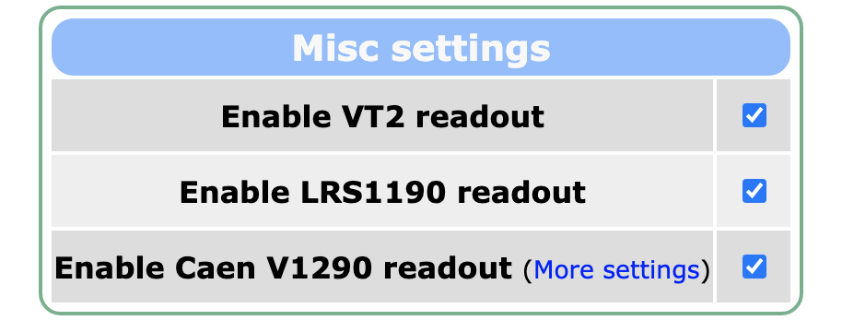
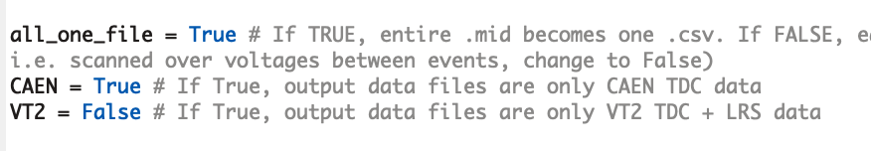
A Few Other Initial Settings...
all_one_file: If TRUE, resulting output data .csv files correspond to each MIDAS file
If FALSE, output .csv files correspond to each loop within in each MIDAS file (see TITAN DAQ documentation)
Default is TRUE for PI-ICR analysis
CAEN and VT2: Set TRUE whichever TDC is being used to read out data; this is indicated in the MPET DAQ under Scan
Default is CAEN = TRUE
Note: Cannot both be true for data converting in script -- this will trigger an error

Slide 5
A Few Other Initial Settings...for Test Data
testing: If you are using test data from MIDAS that DOES NOT include a reference file (i.e. a Tacc of 0), set to TRUE
Automatically assigns the last file a Tacc of 0, as needed to run through the script
Otherwise, set to FALSE
This is the default for normal data

Slide 6
Getting Started
midas_to_phiat.py is automatically run as part of PhIAT.m (see PhIAT.m documentation)
However, it can be run on its own as well:
The input is an address to a directory of MIDAS files (.mid or .mid.lz4)
The files in this directory are gathered together via glob

Slide 7
Data
For every event (i.e. ion hit on the detector), four pieces of data are relevant:
X Position [mm]: X coordinate of ion hit on detector (i.e. delay line anode)
Y Position [mm]: Y coordinate of ion hit on detector (i.e. delay line anode)
Time-of-Flight [s]: Time-of-flight between ejection from the trap to ion hit on MCP
Trigger [int]: Number of trigger an ion hit came during (starting from 0 at file’s beginning) -- CAEN 25ps ONLY
Timestamp [s]: Timestamp of event relative to initial trigger time -- VT2 ONLY

Slide 8
Data -- CAEN 25ps TDC
X/Y Position: Determined via timing pulses in delay line anode
Correspond to caen_tdc_parsed.pos_x_mm (or pos_y_mm) in ../titan_data/mpet/__init__.py
ToF: Time between trap ejection and ion contact with MCP
Corresponds to caen_tdc_parsed.mcp_tof_secs
Trigger: Trigger number at which an ion event occurred
Corresponds to caen_tdc_raw.trigger_count
NOTE: Since this is raw data (i.e. each ion hit does not yet correspond to one event), need to specify a channel_id to get just one trigger value per ion hit

Slide 9
Data -- VT2 TDC
X/Y Position: Determined via LeCroy 1190 Position Analyzer
Correspond to pos_data.x (or y) in ../titan_data/mpet/__init__.py
NOTE: The LC1190 DOES NOT give reliable position data...
ToF: Time between trap ejection and ion contact with MCP
Corresponds to vt2_data.tof_secs
NOTE: Since this is raw data (i.e. each ion hit does not yet correspond to one event), need to specify a channel_ids to get just one trigger value per ion hit
Timestamp: Timestamp of event relative to initial trigger time
Corresponds to vt2_data.time_secs
NOTE: Since this is raw data (i.e. each ion hit does not yet correspond to one event), need to specify a channel_ids to get just one trigger value per ion hit

Slide 10
Ion-Ion Interaction Data Cuts
We want to minimize any ion-ion interaction effects in the trap on results, so we discard any data where > N total ions were in the trap together
N corresponds to ion_ion_cut_min
In practice, we throw away data with > N events in the same trigger window
ONLY works with CAEN 25ps TDC Data

Slide 11
Determining Ion Rates
We want to determine the rate at which ion events are occurring
We determine a gating time t (gating_rate [ms]) and determine the number of events that occur within each gating time window across the file
i.e. events between 0-t, events between t-2t, etc.
We approximate the global event time for each event as the total trap time (trap_time) times the trigger number of that event
We record the approximate global gate time, the number of events, and the rate of those events (num_events/t) for each gating time window

Slide 12
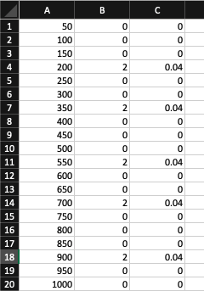
Ion Rate .csv
A .csv file is printed with the recorded ion rate data:
Column 1: Approximate Global Gate Time [ms]
(gating window number)*t
Column 2: Number of Events in each Window [int]
Column 3: Rate of Incoming Events in each Window [events/ms]
num_events/t
Saved as original_MIDAS_filename.mid_ion_rate.csv

Slide 13
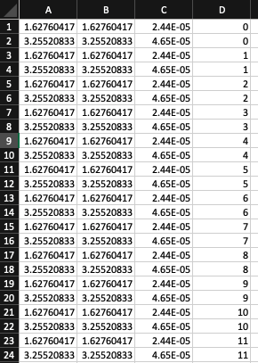
Main Data .csv
A .csv is printed with the data described on slides 7-9
Column 1: X Position [mm]
Column 2: Y Position [mm]
Column 3: Time-of-Flight [s]
Column 4: Trigger Number [int] (CAEN) OR Timestamp [s] (VT2)
Saved as original_MIDAS_filename.mid_.csv
Main Data and Ion Rate CSVs are created for each MIDAS file in the input directory

Slide 14

Pairing Final and Reference Files
For each final file (Tacc > 0), we need to pair it with the reference file (Tacc = 0) closest to it in time
We determine the midpoint time of each file (i.e. file_start + (file_end - file_start)/2)
file_start is event_time[0] and file_end is event_time[-1] from titan_data/mpet/__init__.py
We find the difference between the midpoint time of the final file and all reference files, and pair the actual file with the reference file of smallest difference

Slide 15
File List .csv
A .csv is printed with:
Column 1: Addresses of Main File CSVs
Column 2: Accumulation Times of each File [s]
Column 3: Reference File Assignment for each Final File
If file is a reference file, this is blank
Numbering of associated references correspondings to ordering of references in first column
Saved as inputDirectoryName_firstTaccFile_List.csv
i.e. Test_CAENOffset_0.03File_List.csv
Saved OUTSIDE the input directory

Slide 16
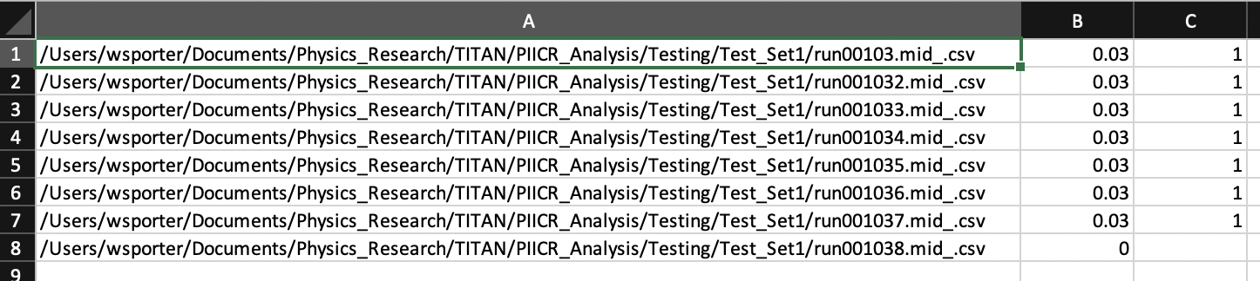
File List .csv Example
All reference files will come after all final files

Slide 17
More on titan_data and the primary script referenced in this code (../mpet/__init__.py) can be found:
https://bitbucket.org/ttriumfdaq/titan_data/src/master/
TITAN DAQ documentation
Please contact Sam Porter (wporter@triumf.ca) if you have any questions

